Slide 1
Basics of Mac Addressing
Dr.Mohammed Abdalla Mahmoud Youssif
1

Slide 2
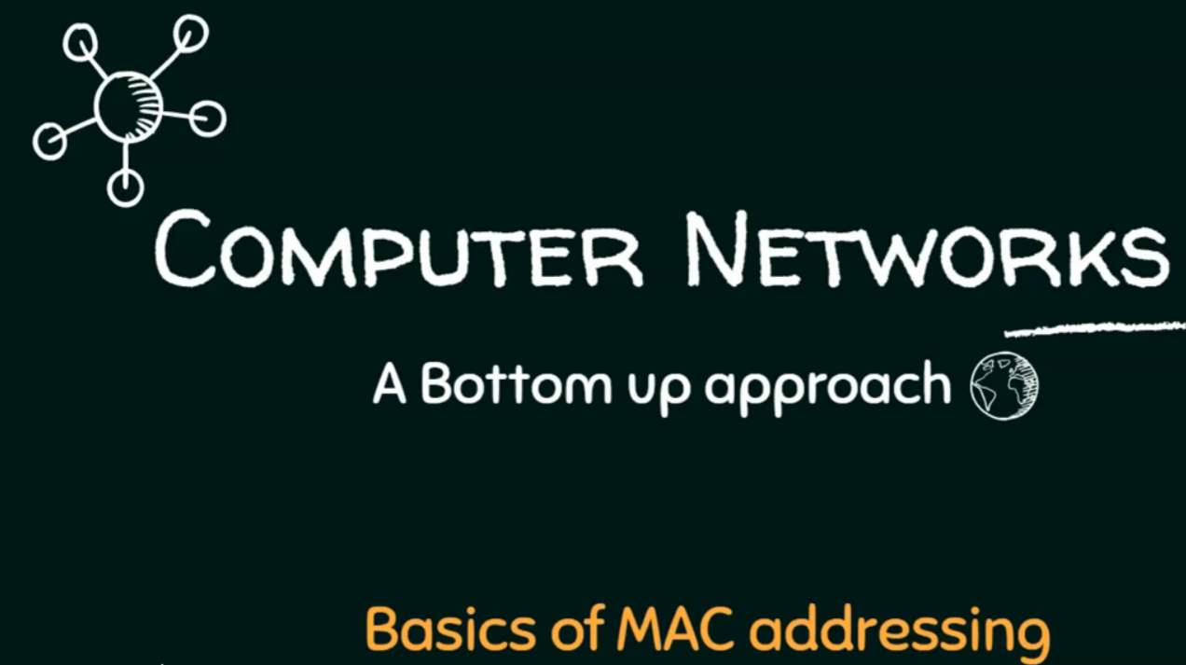
2
Notes:
2

Slide 3
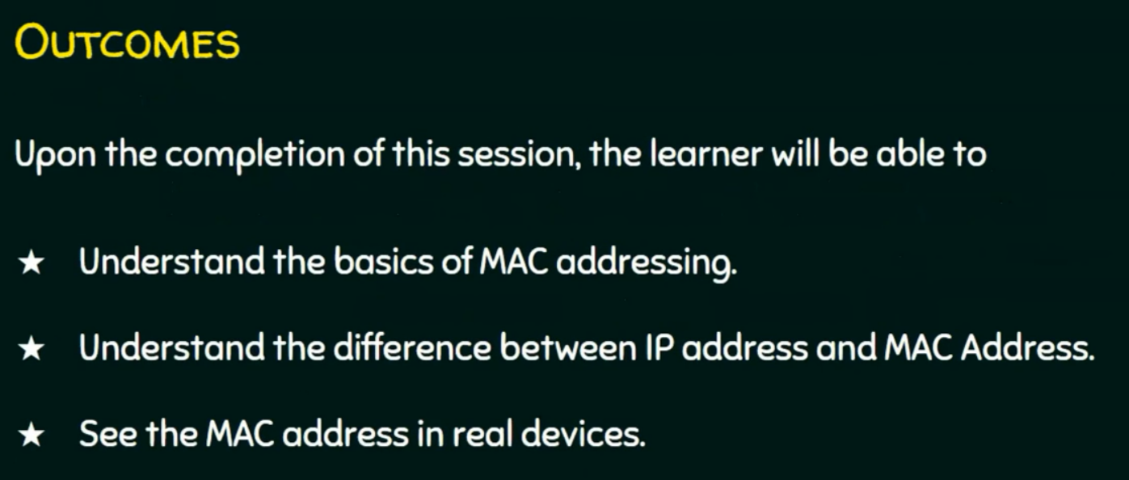
3
Notes:
3

Slide 4
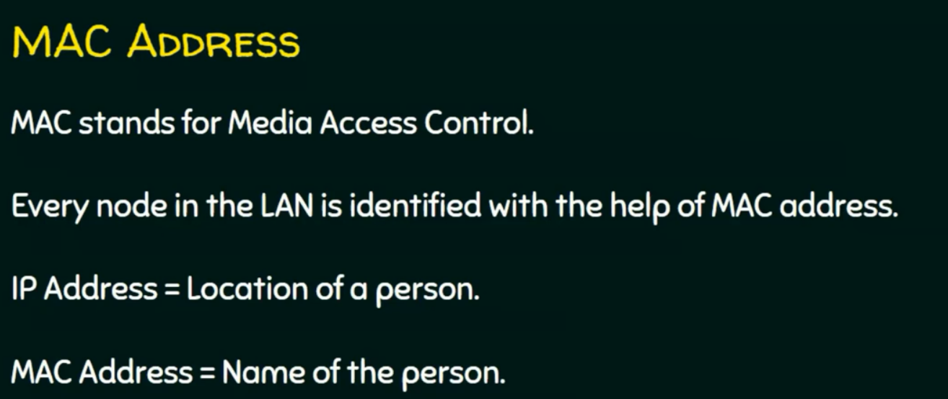
4
Notes:
location can be changed but name can not be changed.
4

Slide 5
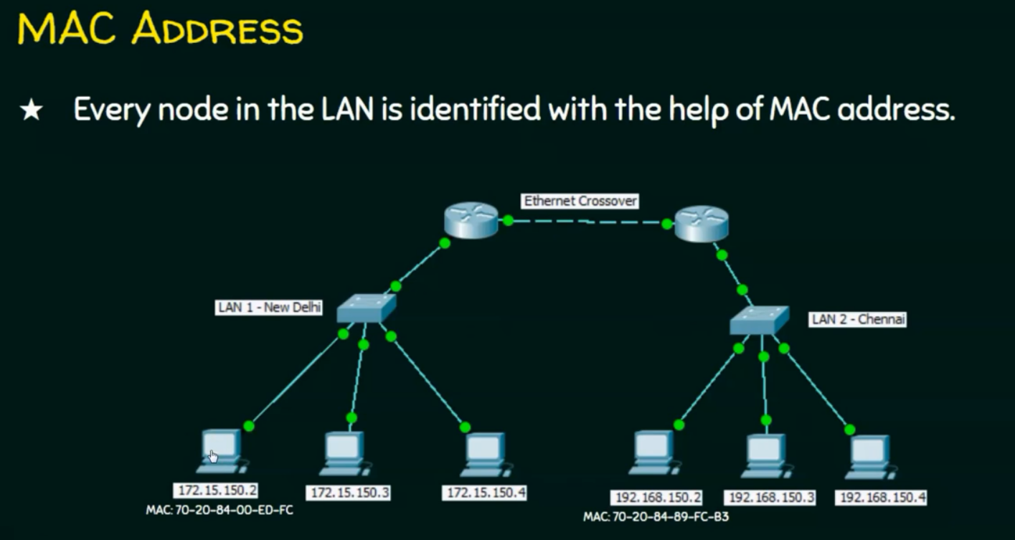
5
Notes:
- Switch take decision based on th Mac address, but router take the decision based on the ip address
- Switch maintain mac address table to know which computer it have to forward the data.
5

Slide 6
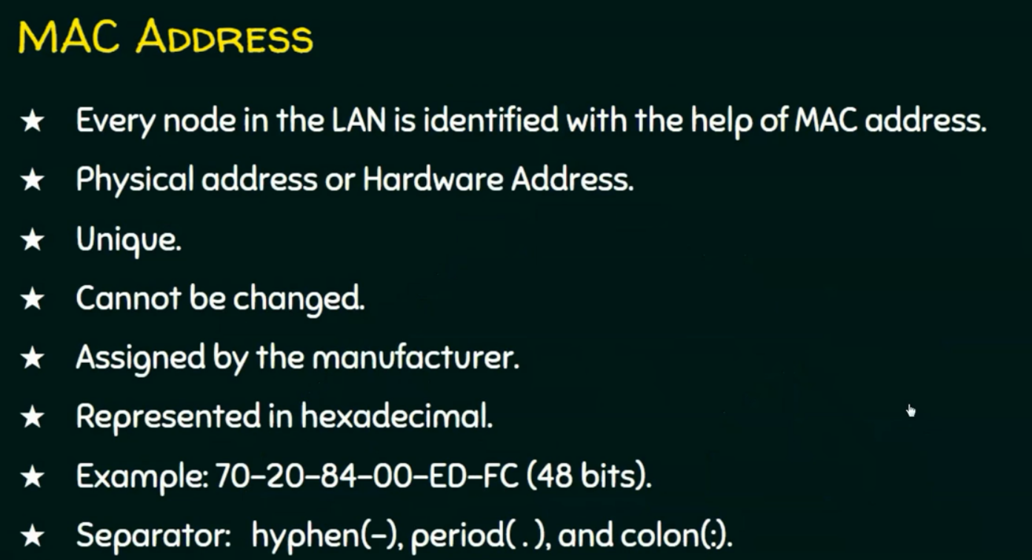
6
Notes:
6

Slide 7
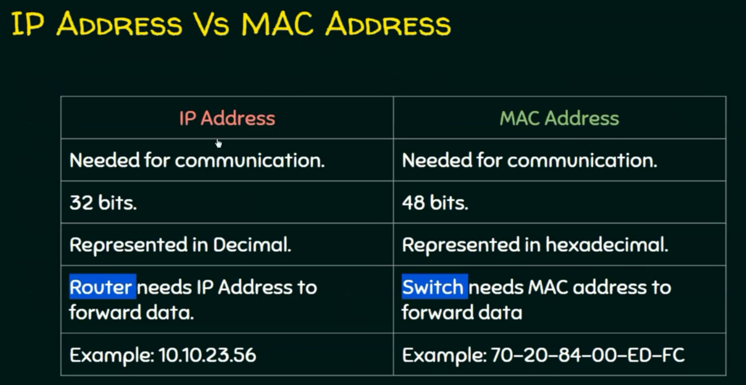
7
Notes:
7

Slide 8
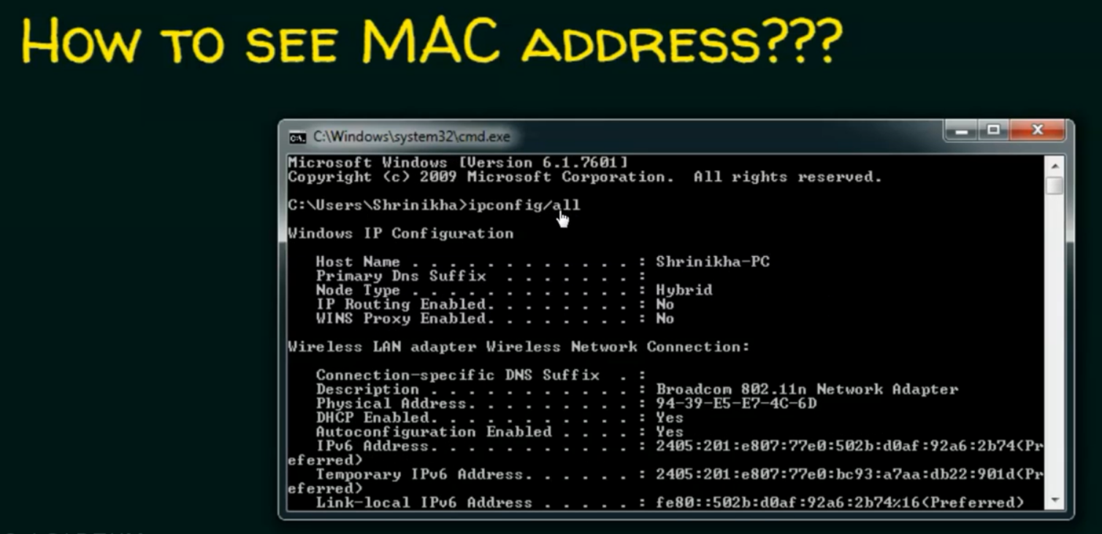
8
Notes:
8

Slide 9
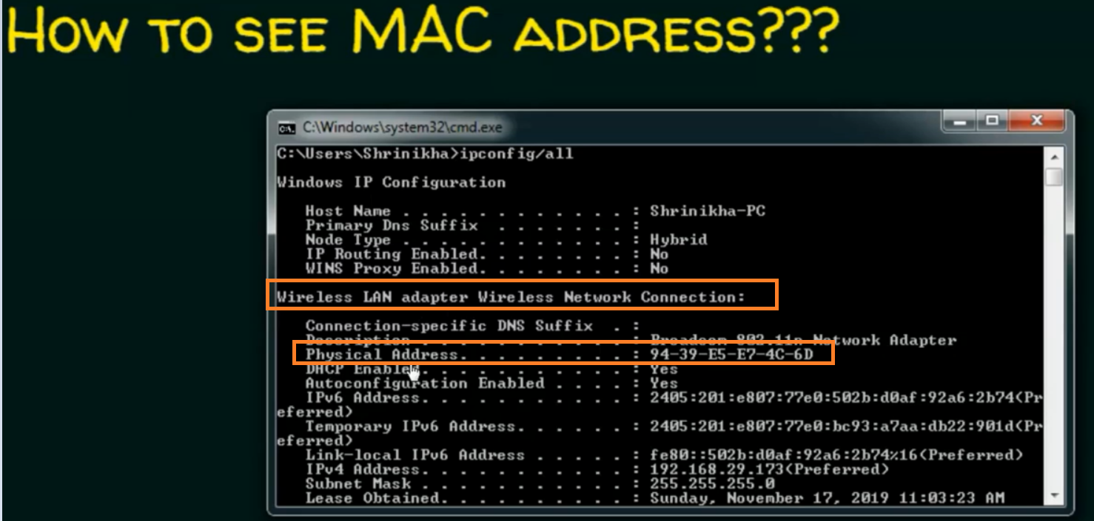
9
Notes:
Physical address mean mac address.
9

Slide 10
Questions ?
10
Notes:
10

